Slide 2
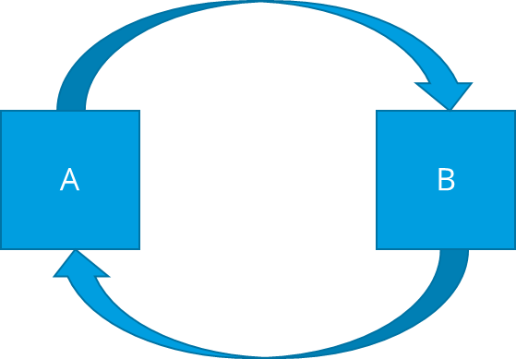
Disclaimer
This course is for you. Don’t hesitate to ask us!
Many of you will have questions and we can’t answer all of them instantaneously, please respect that.
The scope of the course is to give you an overview to modern Machine Learning/Deep Learning and that you are able to build some of the most important architectures on your own. We will try to skip heavy math/coding but we can’t really leave out everything. Some things will be hard to explain since you need some domain knowledge from Computer Science, but take your time and think about it!
Sometimes you require knowledge of A to understand B and vice versa! → Try to keep going!
To help you to get over this obstacle, course will consist of lectures and exercises which will also serve as a kind of proof.

Slide 3
Schedule
Monday
Introduction
HPC and GIT
Jupyter Notebooks
Python Basics
Neural Networks with Keras
Keras Basics
MLP
Tuesday
Convolutional Neuronal Networks
BatchNorm
Activation Maps
CAM/GradCam
Wednesday
Recurrent Neural Networks
GAN
Autoencoder/VAE
Thursday
Do it yourself! Hackday!

Slide 4
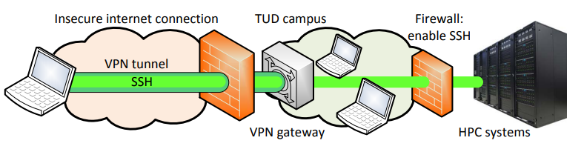


High Performance Computing
Through this course we will need compute power that could exceed the limitations of your PC/Laptop at home.
To run everything smoothly we are lucky to be supported by the TU Dresden Supercomputer TAURUS. This so called Hight Performance Computing (HPC) System is not accessible to public use and can only be used from the inside of TU Dresden Network
HPC Cluster
Your PC
Slurm System
7 CPU = 1 GPU
(Up tp 4 GPU per Node)
Node
requesting compute power
Checking for available resource
Free
Occupied

Slide 5
High Performance Computing
Through this course we will need compute power that could exceed the limitations of your PC/Laptop at home.
To run everything smoothly we are lucky to be supported by the TU Dresden Supercomputer TAURUS. This so called Hight Performance Computing (HPC) System is not accessible to public use and can only be used from the inside of TU Dresden Network
Slurm will allocate the resources requested by you without checking for sanity.
(If you need more request more. But be humble!)
HPC Cluster
Your PC
Slurm System
7 CPU = 1 GPU
(Up tp 4 GPU per Node)
Node
requesting compute power
Checking for available resource
Free
Occupied

Slide 6

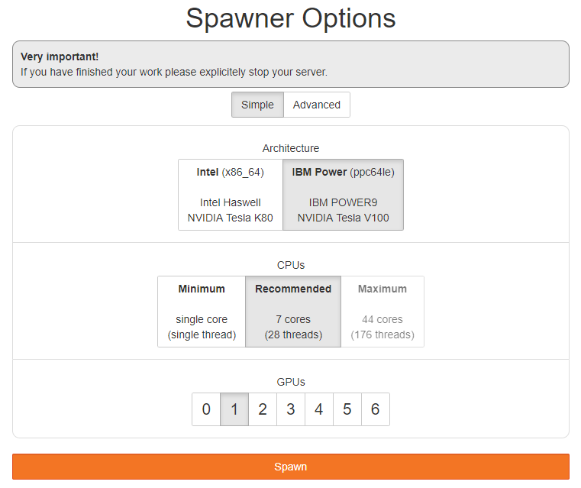
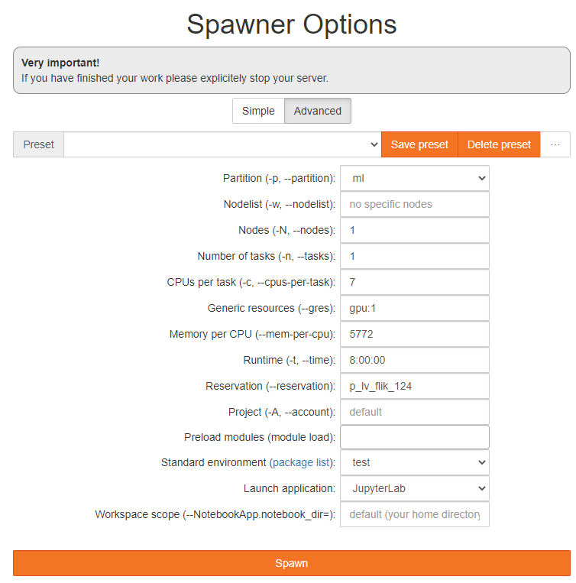



How to connect to HPC through the course
Make sure your you are connecting from the secure network within TU Dresden!
Go to your browser and visit:
https://taurus.hrsk.tu-dresden.de/jupyter
If you are within the TU network you can click on the button to enter this screen
Click
Check
Wait
Click

Slide 7
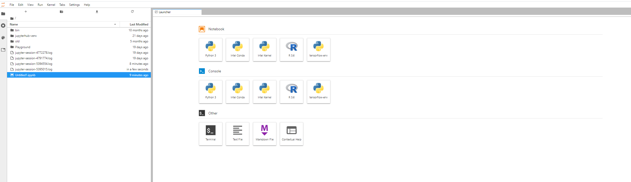

How to connect to HPC through the course
This is your „home“ screen for Jupyter on the HPC
Your screen will look a little different but don‘t worry!
Yep! ☺

Slide 8
your current folder name
your current „tab“
Jupyter Hub
← … means „home“
All your folders
(this will probably be empty)
All the programs alredy installed for you
The Jupyter Hub is GUI on top of the Linux running on the HPC, which is accessible by the command line. (don‘t worry we will only touch this in a single case)

Slide 9

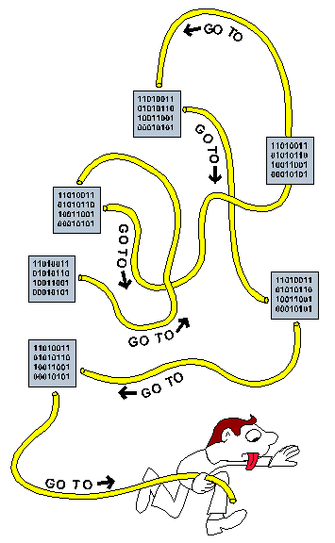
GitHub
We prepared your materials to be downloaded via GitHub (Microsoft)
Github is an online code sharing platform which is very popular in Computer Science (especially in ML)
Using a „Git“ is a very helpful tool in programing alone and with colaborateurs because of his version controll. (Coding a giant project with many collegues can end in a codemess)
Unfortunatly we don‘t have the time to introduce you to git in this course. But we encourage you to learn using it from one of the many very good resources already out on the internet.
For the sake of simplicity we just show you how to download an existing project (our material) from the github server to your HPC local folder.
Git is already installed for you in the Taurus! ☺

Slide 10
How to get the course material with Git?
Click
In the new terminal window write:
Press Enter

Slide 11
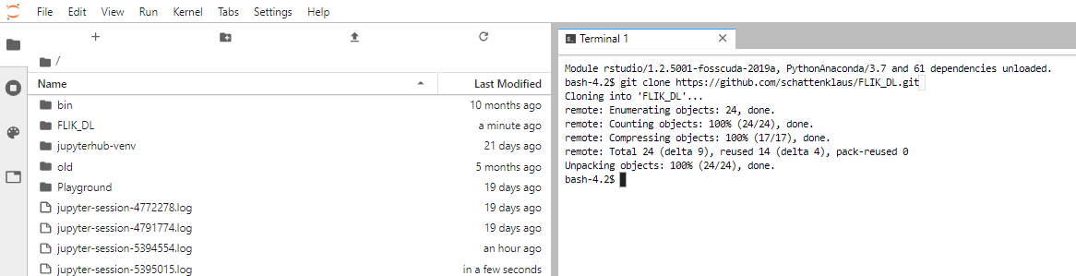
How to get the course material with Git?
You should see the new „FLIK_DL“ folder in your directory → Click on it to excess all the course materials (our slides and notebooks on a daily basis)
Click
This is a local copy of our materials on your Taurus. If you unintentionally deleted something just redo the whole cloning process. You can now close the terminal window.

Slide 12
1. Exercise Setup your HPC resources and download the course material to your home folder via GIT!

Slide 13



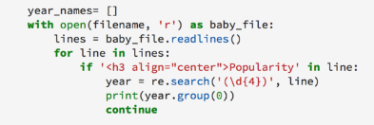
Python
provides
You
Your Machine
uses
Instruction Set
Compiler
translates
„101101 “
write
Is read by
Very popular programming language in the scientific comunity!
Reason: easy understandable code, free of charge and modular

Slide 14
Python Modules
Packages/Modules are nothing else than classes with functions written by other users free of charge!
Your function/package
Provide functionality via more „toplevel“ fuctions
,
Packages
Numpy
Sklearn
Pandas
…
Python Basic
Instruction set

Slide 15
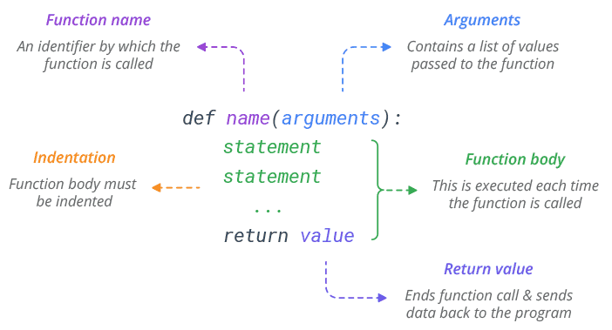
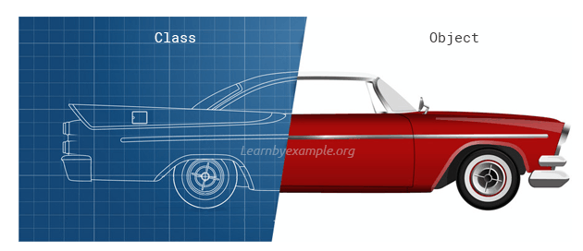
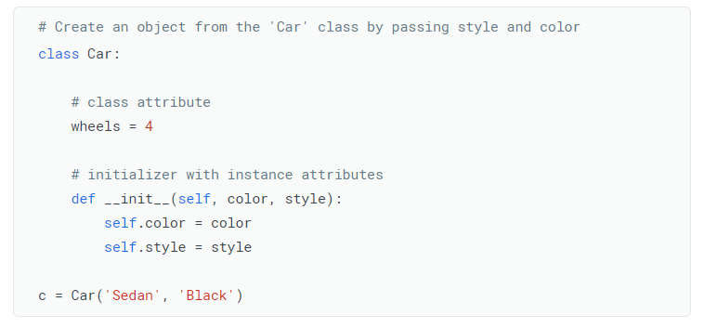
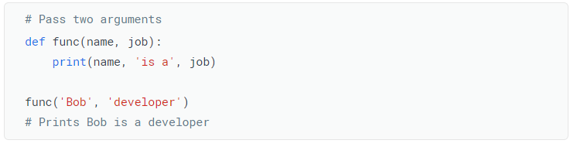
Python Code Explained classes and functions
Python groups code blocks by looking at the intent.
The def statement only creates a function but does not call it. After the def has run, you can can call (run) the function by adding parentheses after the function’s name.

Slide 16
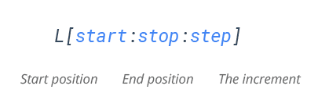
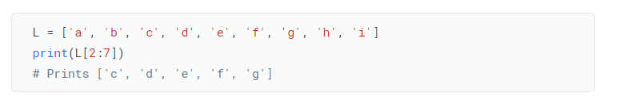
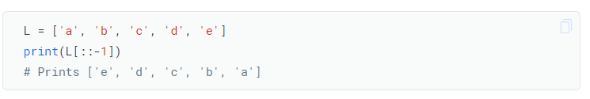
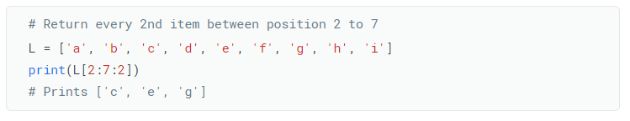
Slicing
Reverse a list
To access a range of items in a list or array, you need to slice a list. One way to do this is to use the simple slicing operator “:”
Only every 2nd value

Slide 17
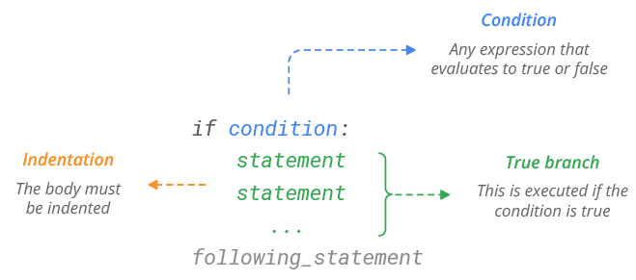
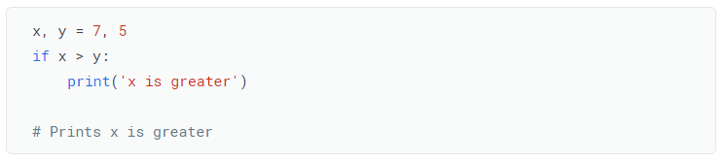
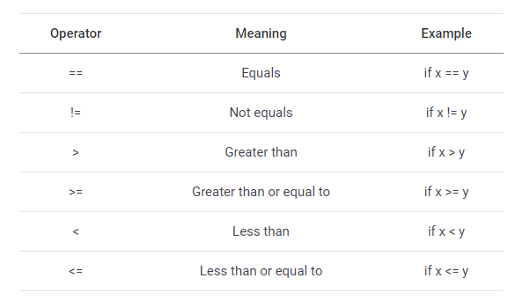
Python Code Explained if loop

Slide 18
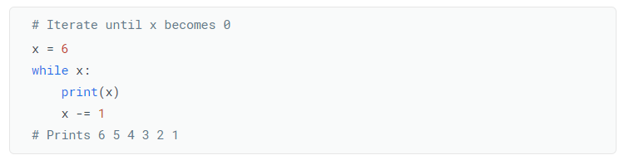
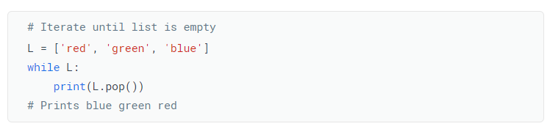
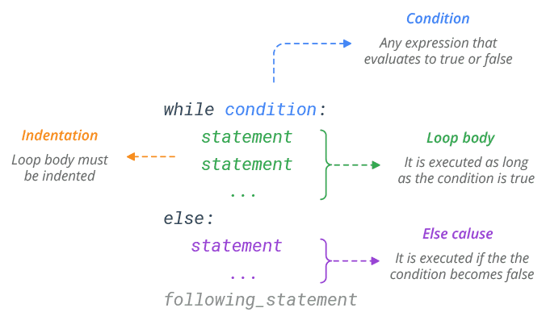
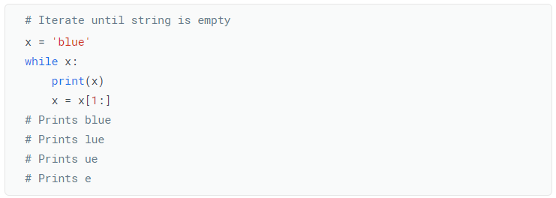
Python Code Explained while loop
Any non-zero value or nonempty container is considered TRUE; whereas Zero, None, and empty container is considered FALSE.

Slide 19
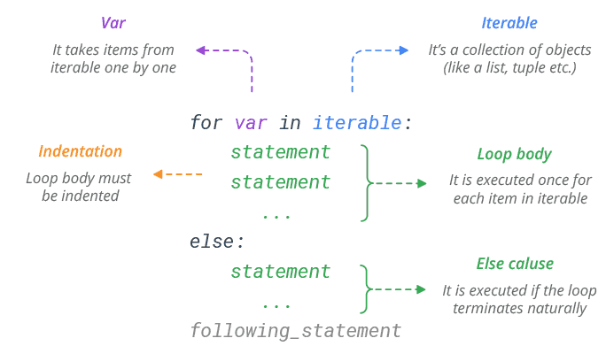
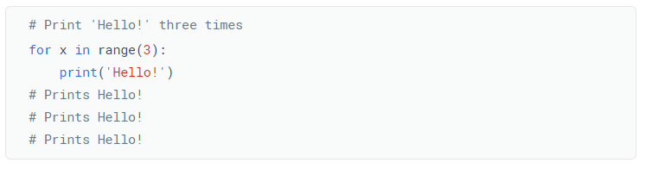
Python Code Explained for loop

Slide 20
2. Exercise Open the notebook „Python_Intro“ and follow the instructions

